Slide 1
Multivariate Analysis of Variance

Slide 2
Today . . .
  Resampling when assumptions fail
  Incorporating covariates into a MANOVA
  Extending MANOVA to collections of different measures—profile analysis and doubly repeated designs.

Slide 3
If the assumptions underlying the MANOVA (homogeneous covariance matrices, multivariate normality) are not viable, alternative approaches can be taken that do not make these assumptions: bootstrapping and randomization tests.
When participants are randomly assigned to groups, we assume under the null hypothesis that these assignments are inconsequential or arbitrary. In a randomization test, we actually make the group assignments arbitrary.

Slide 4
On each of a large number of trials, the group assignments are shuffled randomly so that participants will get new group assignments that may not match their original assignments.
The statistical analyses are conducted on each of these reshuffled samples.
The location of parameter estimates (e.g., Wilks’ Λ) from the original analysis in the resulting randomization distributions is examined. If the original estimates are rare in the null-consistent randomization distributions, the null is rejected.

Slide 5
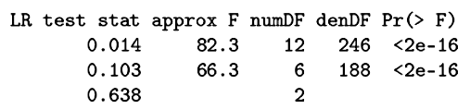
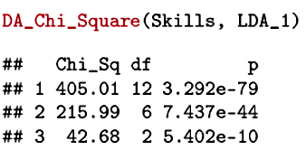
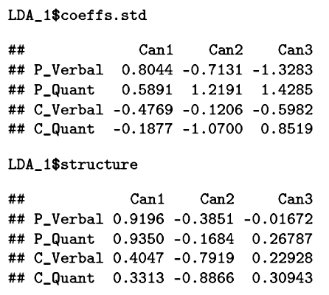
All three functions were significant in the original analysis.

Slide 6
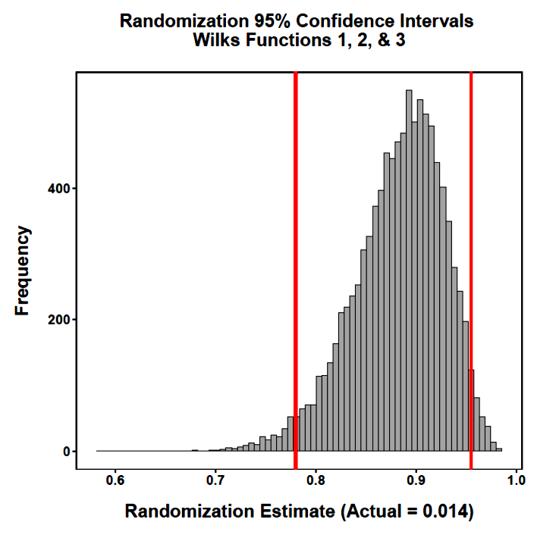
The obtained empirical value falls outside the 95% CI from the null-consistent randomization distribution. We reject the null. The groups can be separated by at least one discriminant function.

Slide 7
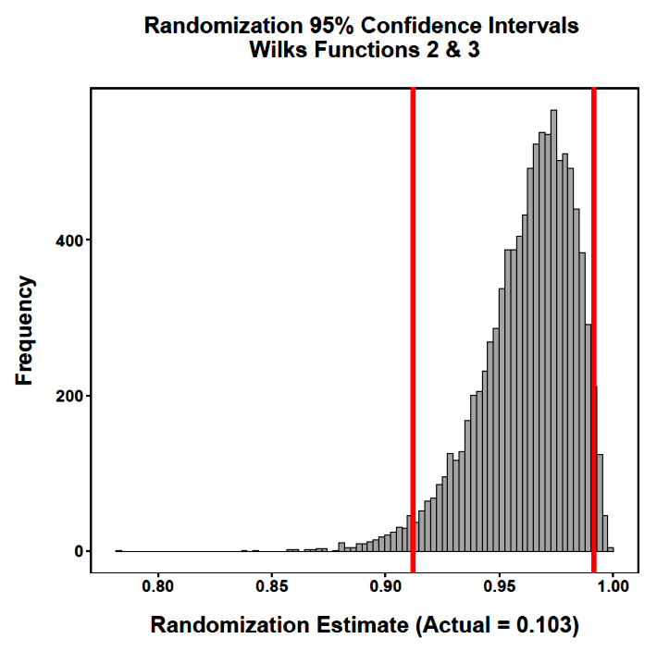
The obtained empirical value falls outside the 95% CI from the null-consistent randomization distribution. The groups can be separated by at least two discriminant functions.

Slide 8
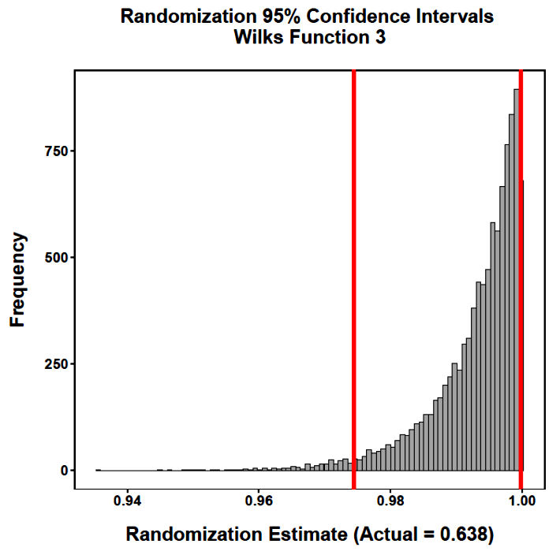
The obtained empirical value falls outside the 95% CI from the null-consistent randomization distribution. The groups can be separated by the third discriminant function.

Slide 9
Adding covariates to a multivariate analysis (MANCOVA) is a direct extension of univariate analysis of covariance.
The goals in ANCOVA are:
  to reduce the error for testing a target effect
  to adjust for differences that might otherwise make inferences ambiguous
The interest is in asking a question that begins, “controlling for . . .”

Slide 10
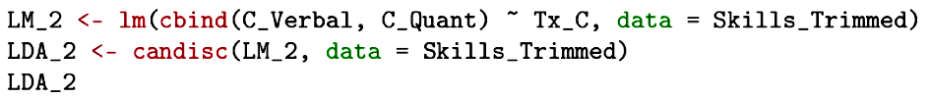
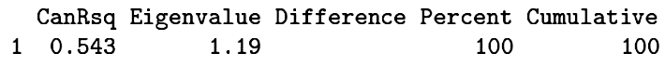
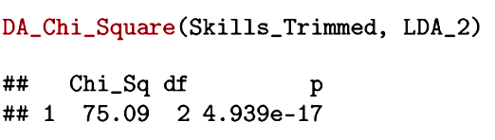
This simple MANOVA determines the linear combination of the two computer GRE measures that best separates participants who received computer training from those who did not. Only one linear combination is possible here.

Slide 11
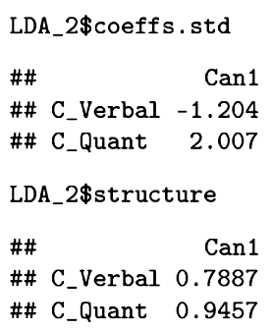
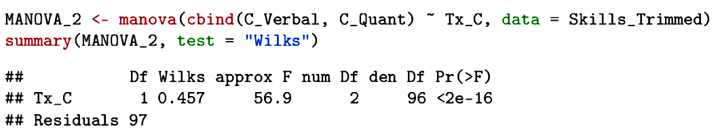
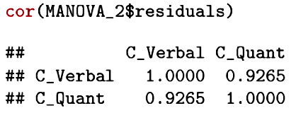
Both measures are positively related to the linear combination that best separates the groups, but the standardized coefficients have opposite signs because of the high correlation between the two measures.

Slide 12
This MANOVA asks the same question, but qualified by “controlling for performance on standard paper GRE measures . . .”
This analysis might be motivated by a concern for whether computer training has a unique effect on computer measures or whether it simply boosts performance on any measure of the talent that was the focus of training.

Slide 13
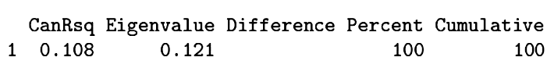

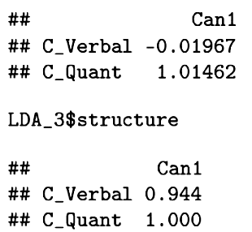
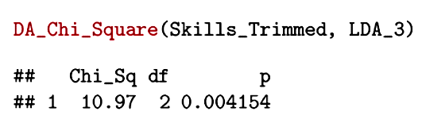
The multivariate tests indicate that it is still possible to separate the groups significantly with a linear combination of the computer measures, controlling for the differences between the groups on the standard measures. But, controlling for the standard measures largely eliminates the independent contribution that the computer verbal measure made to group separation.

Slide 14
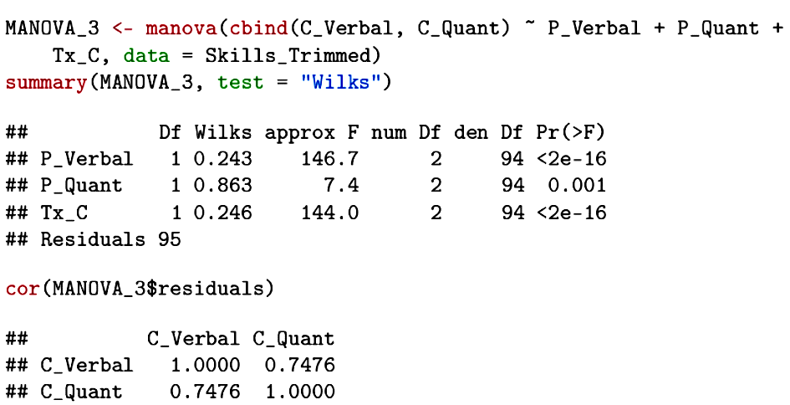
Controlling for the standard paper measures reduces the within-group correlation between the computer measures.

Slide 15
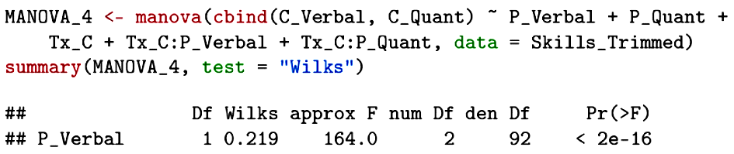
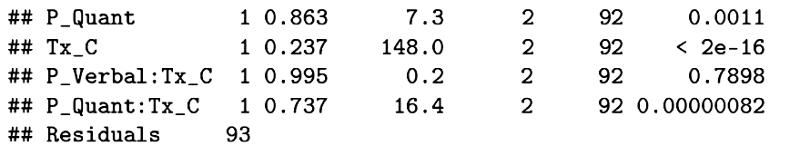
A MANCOVA carries the same assumption of homogeneity of regression that accompanies a univariate analysis of covariance. It is tested in the same way, by examining interactions involving the covariates.

Slide 16
Used carefully, a MANCOVA allows separating the influence of highly correlated variables and isolating the unique influence of treatment effects.
Here it shows that the computer training has a large impact on GRE performance, but seems to have an especially important or unique effect on the computer quantitative measure.
The Covariate x Group interactions would, however, require additional exploration.

Slide 17
Extending MANOVA to repeated measures has some advantages. One of the simplest is a profile analysis.
In a profile analysis, several different measures that use the same scale are compared—their profile is assessed, often by comparing groups.
A key assumption is that the measures can be directly compared—their metrics are the same.
This is no problem when the “different measures” are simple replications over time. The assumption is very important to consider when the measures are truly different conceptually.

Slide 18
When the same measures are collected over time, a profile analysis is the multivariate approach to repeated measures that might be used if the assumptions for a univariate repeated measures ANOVA (e.g., sphericity) are not met.
When used with different measures, collected on one occasion with a common measurement scale, a profile analysis addresses questions such as “is Measure X elevated relative to Measures Y and Z?” If groups are included, the question becomes “is the difference between X and Y greater in Group A than in Group B?”

Slide 19
A profile analysis addresses three major questions:
  Are the profiles parallel? Is the pattern of differences across measures similar for the several groups compared (the interaction)?
  If the profiles are parallel, are they coincident? Coincident and parallel profiles will have no group differences in the between-subjects part of the design (there will be no group main effect).
  If the profiles are parallel, are they also level? The flatness of the profiles is addressed by collapsing across groups and testing for whether the measures are similar in their means (the main effect from the within-subjects part of the design).

Slide 20
In this data set, 11 subtest scores from the WISC, measured on the same scale, were compared for three groups of learning disabled children.
Information
Comprehension
Arithmetic
Similarities
Vocabulary
Digit span
Picture completion
Picture arrangement
Block design
Object assembly
Coding

Slide 21
The three groups of children were formed based on their age preferences for playmates:
  1 = younger
  2 = older
  3 = same

Slide 22
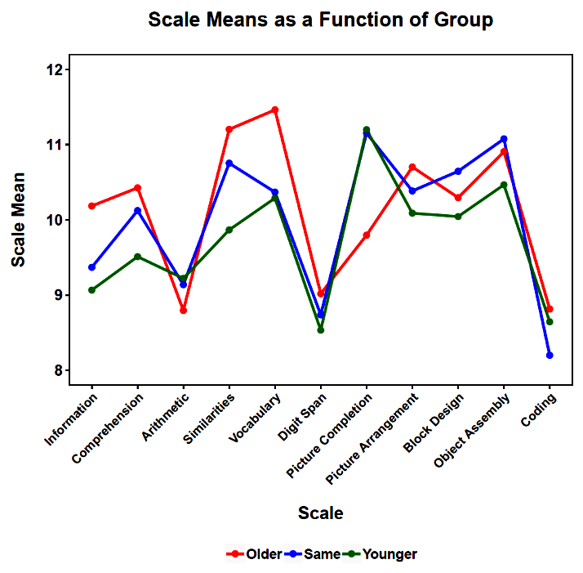

Slide 23
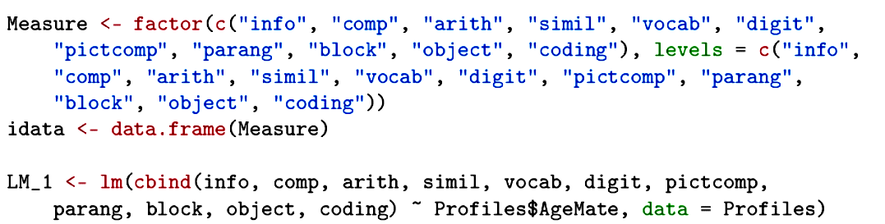
In this analysis, we define the profile as if it had “levels” on a factor called “Measure”. Reminder: the separate measures must be on the same scale or this definition will not make any sense.

Slide 24
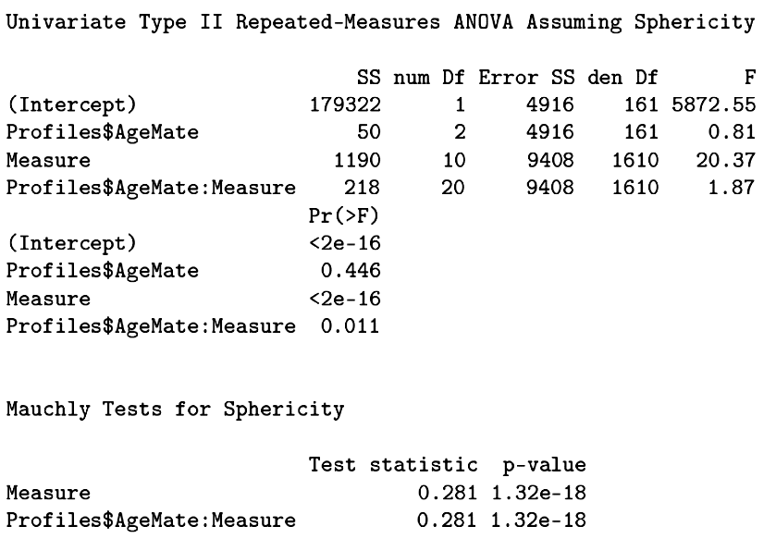
The groups are not different in their overall means. The measures are different collapsed across groups.
The profiles are not parallel. The sphericity assumption is violated. A MANOVA does not have that assumption and can be used to verify the inferences.

Slide 25
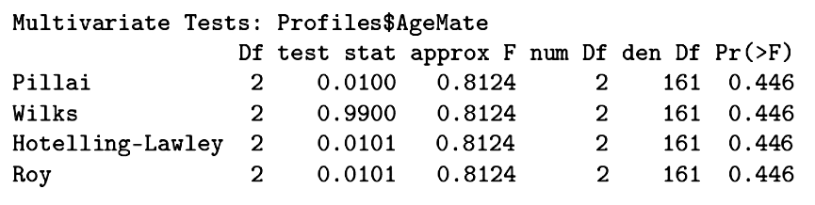
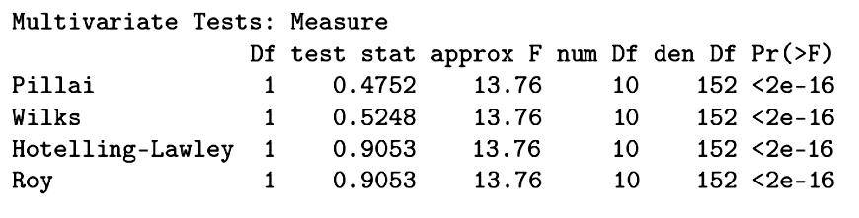
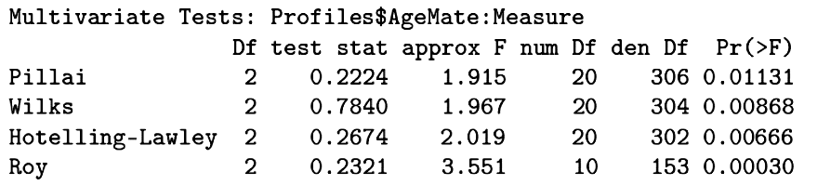

Slide 26
The significant interaction means that the profiles of subscore means are different for the three groups.
There are quite a number of ways that this interaction could be explored to determine the nature of the differences.
A priori hypotheses should be tested with focused contrasts, without any need for Type I error protection.
Exploratory tests should adjust for the number of tests conducted.

Slide 27
When variables have different metrics (are not commensurate), but are measured repeatedly, a doubly multivariate analysis is used.
This approach can be thought of as a multivariate analysis of transformed scores (sums and differences). It can help identify patterns of outcomes that distinguish groups.

Slide 28
In this study, 38 healthy young men and 37 age-matched psychiatric male in-patients were asked to engage in brief 10-minute conversations with two other people (the targets, actually research assistants blind to the study purpose or participant status).
Participants were given some brief background information about the targets before meeting them. Both targets were described as holding steady jobs, having hobbies, and going to school part time.

Slide 29
One target (A) was described as having had a lifetime problem with seasonal allergies. The other target (B) was described has having been hospitalized in the past for a psychiatric problem.
During each interview, the distance the participant sat from the other person (in cm) and the amount of eye contact (in seconds) were assessed. At the end of the 10-minute conversation, participants were asked to rate their liking for the target (on a 7-point scale).

Slide 30
The researchers hypothesized that all participants would distance themselves more from targets believed to have had a psychiatric problem and that they would like this target less than the target with no apparent history of psychiatric problems.
Eye contact, however, was expected to show a different pattern. Participants were expected to engage in more eye contact with targets who were different from them. Healthy participants were expected to have more eye contact with targets thought to have psychiatric problems than with targets believed to be healthy. Psychiatric patients were expected to show the opposite pattern.

Slide 31
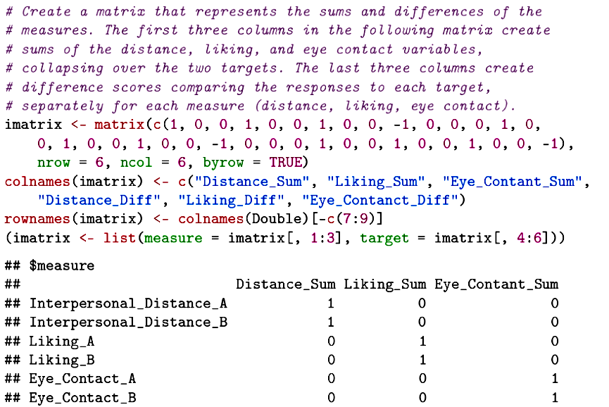

Slide 32
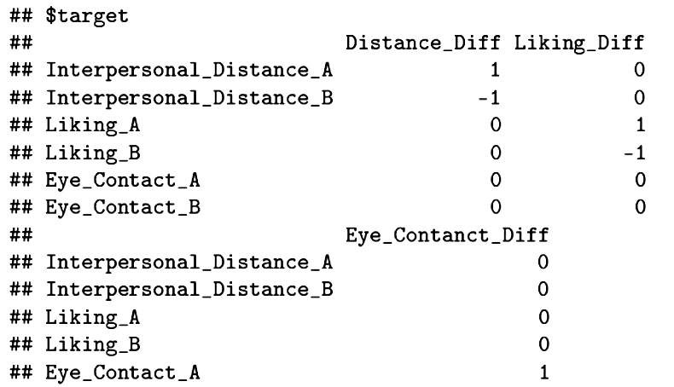
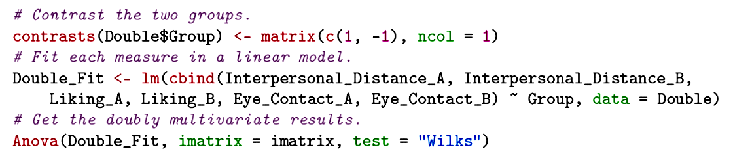

Slide 33
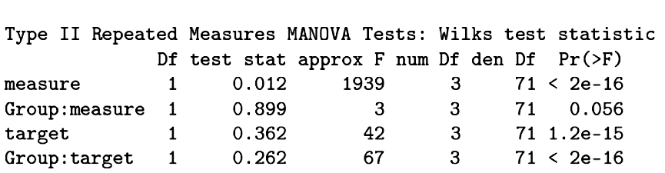
There are group differences in both the sums (marginal) and differences.
Follow-up analyses can help identify the nature of the effects.

Slide 34
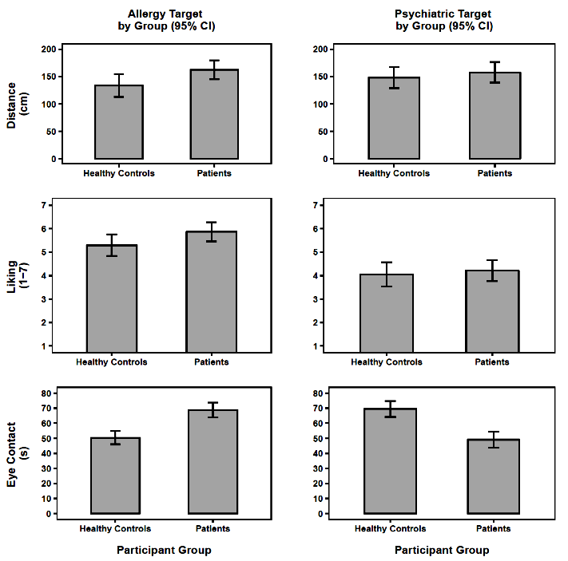

Slide 35
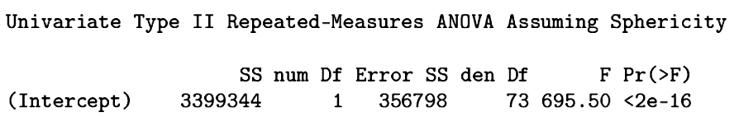
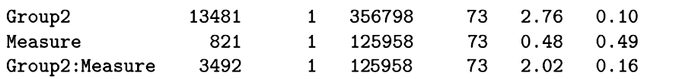
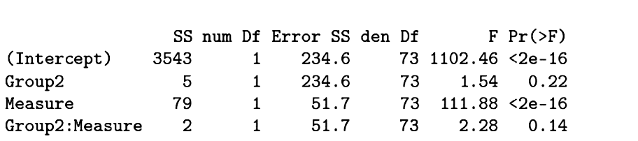
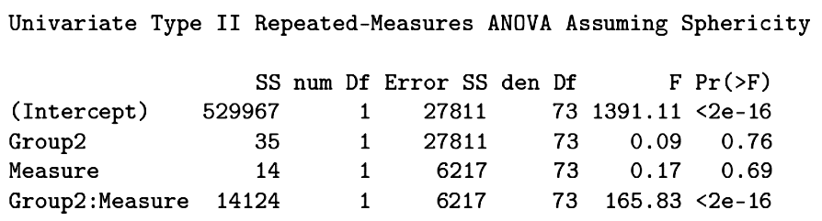
Interpersonal Distance
Liking
Eye Contact
Notes:
These are tests of differences, Target A vs. Target B.

Slide 36
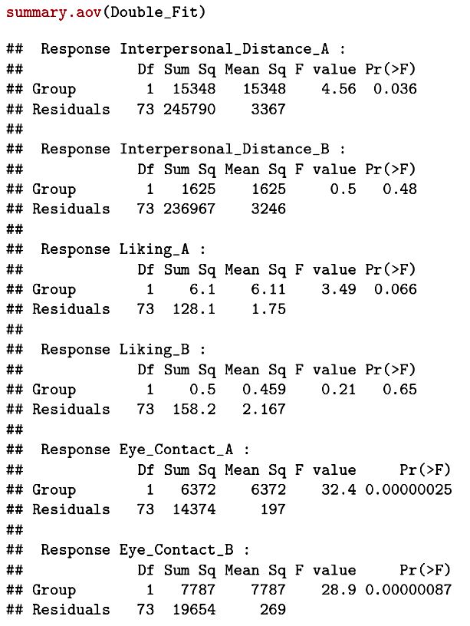
Analyses of variance of each measure provide a low level of follow-up.

Slide 37
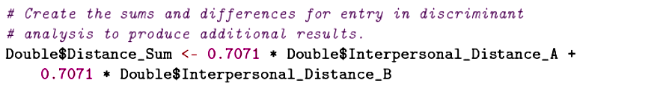
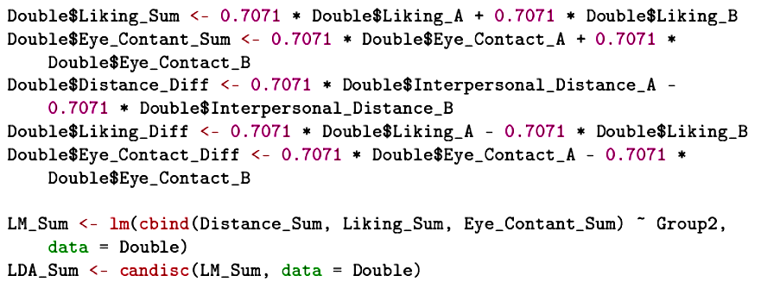
A discriminant analysis can provide additional insight by controlling the correlations among the multiple measures.

Slide 38
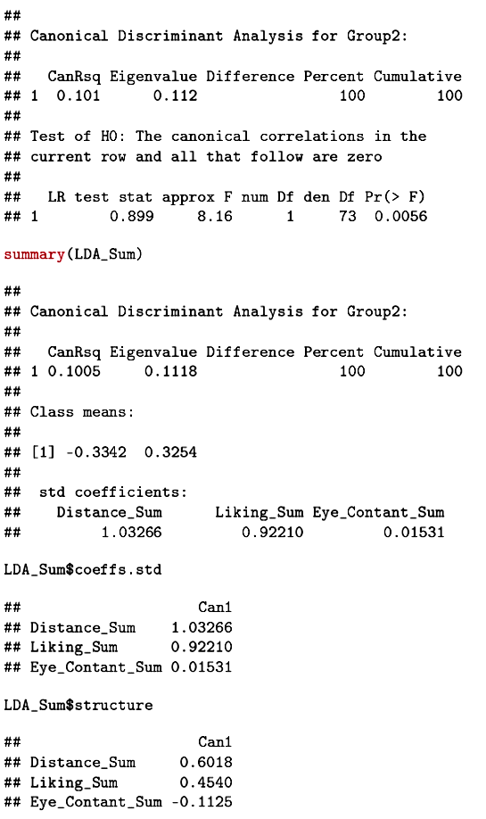
A linear combination of the sum variables (almost entirely due to distance and liking) can separate the healthy controls and patients.

Slide 39

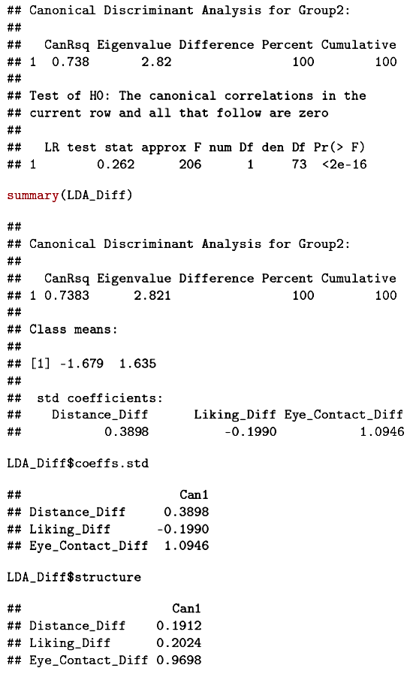
A linear combination of the difference variables (largely due to eye contact) can separate the healthy controls and patients.

Slide 40
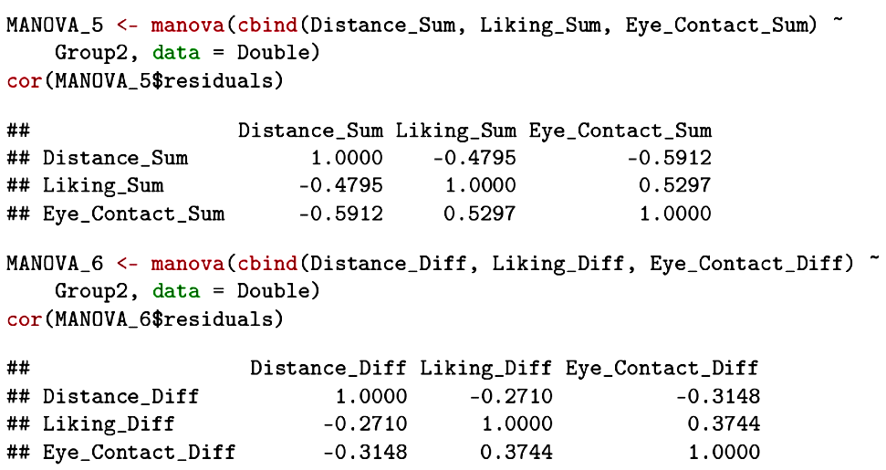
Independent of participant group, distance is negatively related to liking and eye contact. Eye contact and liking are positively related. This is true for both sums and differences.
As the difference in distance from the two targets increases, the difference in liking (and in eye contact) increases in the opposite direction.

Slide 41
Next time . . .
Canonical correlation analysis—finding linear combinations that maximize correlations across sets of variables

